Slide 1
TypeScript
03 Mar 18 | Start
17 May 18 | 2: 24-51
Appendix
Online

Slide 2
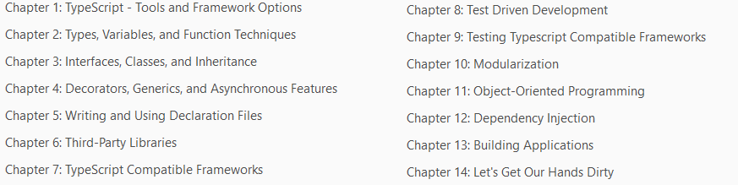
TypeScript
Ch | Date
1 | 19-Mar-18
2
3
4
5
6
7
8
Mastering TypeScript 02 2017

Slide 3
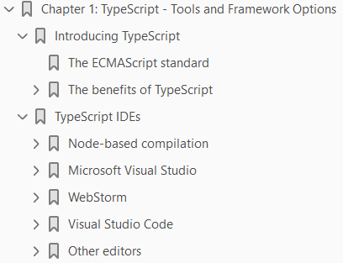
1
TypeScript – Tools & Framework

Slide 4
Intro
JavaScript is a truly ubiquitous language.
Just about every website that you visit in the modern world is using JavaScript to make the site
more responsive
more readable
more attractive to use
Even traditional desktop applications are moving online.
Where we once needed to download and install a program to generate a diagram, or write a document, we can now do all of this on the web, from within the confines of our humble browser.
This is the power of JavaScript
It enables us to rethink the way we use the web.
But it also enables us to rethink the way we use web technologies.

Slide 5
Node
Node, for example, allows JavaScript to run server-side
rendering entire large scale web-sites
complete with session handling
load balancing
database interaction
This shift in thinking about web technologies, however, is only the beginning.

Slide 6
Apache Cordova
Apache Cordova is a fully fledged web server that runs as a native mobile phone application.
This means that we can build a mobile phone application using
HTML
CSS
JavaScript
and then interact with the phones
Accelerometer
geolocation services
file storage
With Cordova, therefore, JavaScript and web technologies have moved into the realm of native mobile phone applications.

Slide 7
Kinoma
Likewise, projects such as Kinoma are using JavaScript to drive devices for the Internet Of Things, running on tiny microprocessors embedded in all sorts of devices.
Espruino is a microcontroller chip purposefully designed to run JavaScript.
Learning JavaScript, therefore, means that you have the ability to build
Websites
mobile phone applications
even control microprocessors on embedded devices
JavaScript is becoming more and more popular, is being supported on more and more hardware, and is filtering through to nearly every corner of computing.

Slide 8
JavaScript
The JavaScript language is not a difficult language to learn, but it does present challenges when writing large, complex programs.
One of these challenges is that JavaScript is an interpreted language and therefore has no compilation step.
The only time you will know if you have made a simple syntax error is when you run the entire application through the run-time interpreter.
Another challenge is that it is also not an object-oriented language, and it takes great care and discipline to build good, maintainable, and understandable JavaScript.
For programmers that are moving from other object-oriented languages, such as Java, C#, or C++, JavaScript can seem like a completely foreign environment.

Slide 9
TypeScript
TypeScript bridges this gap.
It is a strongly typed, object-oriented language that uses a compiler to generate JavaScript.
It therefore allows us to use well known object-oriented techniques and design patterns to build JavaScript applications.
Bear in mind that TypeScript-generated JavaScript is just plain JavaScript, and so will run wherever JavaScript can run
in the browser
on the server
on a mobile device
on an embedded device

Slide 10
Agenda
This chapter is divided into two main sections.
The first section is a quick overview of some of the benefits of using TypeScript, and the second section deals with setting up a TypeScript development environment.
If you are an experienced TypeScript programmer, and already have a development environment set up, then you might want to skip this chapter.
If you have never worked with TypeScript before, and have picked up this book because you want to understand what TypeScript can do, then read on.
We will cover the following topics in this chapter:
The benefits of TypeScript
Compilation
Strong typing
Integration with popular JavaScript libraries
Encapsulation
Private and public member variables

Slide 11
Agenda |
Setting up a development environment
Visual Studio
WebStorm
Visual Studio Code
Other editors and grunt

Slide 12
Introducing TypeScript
TypeScript is both a language and a set of tools to generate JavaScript.
It was designed by Anders Hejlsberg at Microsoft (the designer of C#), and is an open source project to help developers write enterprise-scale JavaScript.
TypeScript generates JavaScript – it's as simple as that.
Instead of requiring a completely new runtime environment, TypeScript-generated JavaScript can reuse all of the existing
JavaScript tools
Frameworks
the wealth of libraries
that are already available for JavaScript.
The TypeScript language and compiler, however, bring the development of JavaScript closer to a more traditional object-oriented experience.

Slide 13
The ECMAScript Standard
JavaScript as a language has been around for a long time, and is governed by a language feature standard.
The language defined in this standard is called ECMAScript, and each JavaScript interpreter must deliver functions and features that conform to this standard.
The ECMAScript standard was published in 1999 and is known as ECMA-262, third edition.
Leaders from Yahoo, Google, and Microsoft tabled an alternate proposal, which they called ECMAScript 3.1.
This proposal was numbered 3.1, as it was a smaller feature set of the third edition, and sat between edition three and four of the standard.
The proposal for a complete language overhaul was eventually adopted as the fifth edition of the standard, and was called ECMAScript 5.
The ECMAScript fourth edition was never published, but it was decided to merge the best features of both the fourth edition and the 3.1 feature set into a sixth edition named ECMAScript Harmony.
The TypeScript compiler has a parameter that can switch between different versions of the ECMAScript standard.

Slide 14
The ECMAScript Standard |
TypeScript currently supports
ECMAScript 3
ECMAScript 5
ECMAScript 6
ECMAScript 7 (also known as ECMAScript 2016)
When the compiler runs over your TypeScript, it will generate compile errors if the code you are attempting to compile is not valid for that standard.
The team at Microsoft has committed to following the ECMAScript standards in any new versions of the TypeScript compiler, so as new editions are adopted, the TypeScript language and compiler will follow suit.
An understanding of the finer details of what is included in each release of the ECMAScript standard is outside the scope of this book, but it is important to know that there are differences.
Some browser versions do not support ES5 (IE8 is an example), but most do.
When selecting a version of ECMAScript to target for your projects, you will need to consider which browser versions you will be supporting, or which standard your JavaScript runtime supports.

Slide 15
The Benefits of TypeScript
To give you a flavor of the benefits of TypeScript (and this is by no means the full list), let's take a very quick look at some of the things that TypeScript brings to the table:
A compilation step
Strong or static typing
Type definitions for popular JavaScript libraries
Encapsulation
Private and public member variable decorators

Slide 16
Compiling
One of the most frustrating things about JavaScript development is the lack of a compilation step.
JavaScript is an interpreted language, and therefore needs to be run against an interpreter in order to test that it is valid.
Every JavaScript developer has horror stories that they can recount of hours spent trying to find bugs in their code, only to find that they have missed
a stray closing brace { ,
a simple comma , -
even a double quote " where there should have been a single quote '
Even worse, the real headaches arrive when you
misspell a property name
unwittingly reassign a global variable.
TypeScript will compile your code, and generate compilation errors where it finds these sorts of syntax error.
This is obviously very useful, and can help to highlight errors before the JavaScript is even run.
In large projects, programmers will often need to do large code merges – and with today's tools doing automatic merges, it is surprising how often the compiler will pick up these types of errors.

Slide 17
Compiling |
While tools to do this sort of syntax checking like JSLint have been around for years, it is obviously beneficial to have these tools integrated into your development toolchain.
Using the TypeScript compiler in a continuous integration environment will also fail a build completely when compilation errors are found, further protecting your code base against these types of bugs.

Slide 18
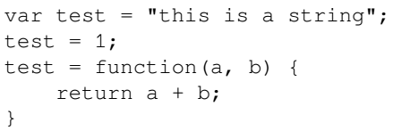
Strong typing
JavaScript is not strongly typed.
It is a language that is very dynamic, and therefore allows objects to change their properties and behavior on-the-fly.
As an example of this, consider the following code:
On the first line of this code snippet, the variable test is bound to a string.
It is then assigned to a number, and finally is redefined completely to be a function that expects two parameters.
This means that the type of the variable test has changed from being a string to being a number, and then to being a function.
Traditional object-oriented languages, however, will not allow the type of a variable to change, hence they are called strongly typed languages.

Slide 19
Strong typing |
While all of the preceding code is valid JavaScript, and therefore could be justified, it is quite easy to see how this could cause runtime errors during execution.
Imagine that you were responsible for writing a library function to add two numbers, and then another developer inadvertently reassigned your function to subtract these numbers instead.
These sorts of error may be easy to spot in a few lines of code, but it becomes increasingly difficult to find and fix these as your code base and your development team grows.
Another feature of strong typing is that the IDE you are working in understands what type of variable you are working with, and can bring better autocomplete or Intellisense options to the fore.

Slide 23
TypeScript IDEs
TypeScript has been released as open-source, and includes both a Windows variant, as well as a Node variant.
This means that the compiler will run on Windows, Linux, OS X, and any other operating system that supports Node.
On Windows environments, we can either install Visual Studio, which will register the tsc.exe (TypeScript compiler) in our c:\Program Files directory, or we can use Node.
On Linux and OS X environments, we will need to use Node.
The various IDEs:
Node-based compilation
Visual Studio 2015
WebStorm
Visual Studio Code
Using grunt

Slide 24
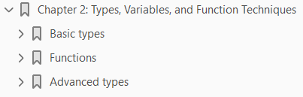
2
Types, Variables, and Function Techniques

Slide 25
Intro
TypeScript introduces strong typing to JavaScript through a simple syntax, referred to by Anders Hejlsberg as “syntactic sugar”.
This “sugar” is what assigns
a type to a variable
a function parameter
even the return type of a function itself
As we discussed in Chapter 1, TypeScript – Tools and Framework Options, the benefits of strong typing include
better error checking,
the ability for an IDE to provide more intelligent code suggestions
the ability to introduce object-oriented techniques into the JavaScript coding experience.
There are a number of basic types that the language uses, such as number, string and boolean, to name a few.
There are also rules by which the TypeScript compiler identifies what the type of a variable is.
Understanding these rules and applying them to your code is a fundamental skill when writing TypeScript code.

Slide 26
Agenda
We will cover the following topics in this chapter:
Basic types and type syntax – strings, numbers, and booleans
Inferred typing and duck typing
Template strings
Arrays
Using for...in and for...of
The any type and explicit casting
Enums
Const enums and const values
The let keyword
Functions and anonymous functions
Optional and default function parameters
Argument arrays
Function callbacks, function signatures, and function overloads
Union types, type guards, and type aliases

Slide 27
NOTE
This chapter is an introduction to the syntax used in the TypeScript language to apply strong typing to JavaScript.
It is intended for readers who have not used TypeScript before, and covers the transition from standard JavaScript to TypeScript.
If you already have experience with TypeScript, and have a good understanding of the topics listed here, then by all means have a quick read through, or skip to the next chapter.

Slide 28
Basic Types
JavaScript variables can hold a number of data types, including
Numbers
Strings
Arrays
Objects
Functions and more
The type of an object in JavaScript is determined by its assignment.
This means that only at the point where we assign a value to a variable does the JavaScript runtime interpreter try to determine what the type of the particular variable is.
While this may work in simple cases, the JavaScript runtime can also reassign the type of a variable depending
on how it is being used
on how it is interacting with other variables
It may assign a number to a string, for example, in certain cases.

Slide 29
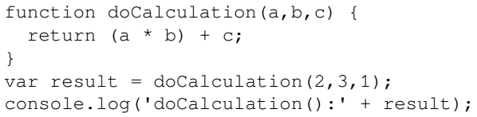


JavaScript Typing
JavaScript objects and variables can be changed or reassigned on-the-fly.
As an example of this, consider the following JavaScript code:
The output of this sample would be:
let's take a look at what happens if we inadvertently call the function with strings instead of numbers:
The output of this code sample is as follows:

Slide 30
JavaScript Typing |
The product of two numbers, that is, (a * b), returns a numeric value, so JavaScript is automatically converting the values "2" and "3" to numbers in order to compute the product, and correctly computing the value 6.
This is a particular rule that JavaScript applies in order to convert strings to numbers, when the result should be a number.
But the addition symbol, that is, +, does not infer that both values are numeric.
Because the argument c is a string, JavaScript is converting the value 6 into a string in order to add two strings.
This results in the string "6" being added to the string "1", which results in the value "61".
Obviously, these sorts of automatic type conversions can cause unwanted behavior in our code.

Slide 31
TypeScript Typing
TypeScript, on the other hand, is a strongly typed language.
Once you have declared a variable to be of type string, you can only assign string values to it.
All further code that uses this variable must treat it as though it has a type of string.
This helps to ensure that code that we write will behave as expected.
TypeScript introduces a very simple syntax to define the type of a variable to ensure that we are using it in the correct manner.
If we break any of these rules, the TypeScript compiler will automatically generate errors, pointing us to the lines of code that are in error.
This is how TypeScript got its name.
It is JavaScript with strong typing, hence TypeScript.

Slide 32
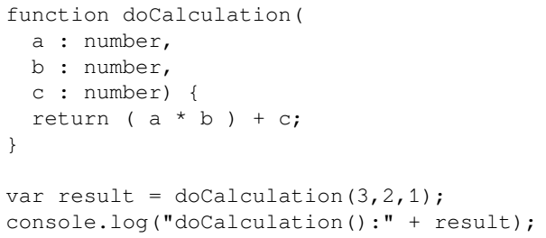
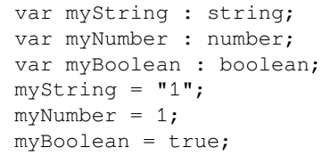
Type Syntax
The TypeScript syntax for declaring the type of a variable is to include a colon (:), after the variable name, and then indicate its type.
Let's rewrite our problematic doCalculation function to only accept numbers.
Consider the following TypeScript code:
The TypeScript compiler generates compile errors if we attempt to mix basic types.

Slide 33

Inferred typing
TypeScript also uses a technique called inferred typing to determine the type of a variable.
It will infer the type of a variable based on its first usage, and then assume the same type for this variable in the rest of your code block.
As an example of this, consider the following TypeScript code:
If we then attempt to assign the inferredString variable (of type string) to the inferredNumber variable (of type number) in the last line of code, TypeScript will generate a familiar error message:

Slide 34
Duck typing
TypeScript also uses a method called duck typing for more complex variable types.
Duck typing means that if it looks like a duck, and quacks like a duck, then it probably is a duck.
Consider the following TypeScript code:
On the second line of code, we are reassigning the value of this complexType variable to another object that also has an id and a name property.
The compiler will use duck typing in this instance to figure out whether this assignment is valid.
When we attempt to reassign the complexType variable to a value that has an id property but not a name property.

Slide 35
Duck typing |
This line of code will generate the following compilation error:

Slide 36


Template strings
TypeScript allows for ES6 template string syntax which provides a convenient method for injecting values into strings.
Consider the following code:
Let's now take a look at the equivalent TypeScript code:
There are two important things to note about this syntax.
Firstly, we have switched the string definition from a double quote (") to an back tick (`).
Secondly, we have used a special ${ ... } syntax within the string to denote a template.
TypeScript will inject the value of any variable that is currently in scope into the string for us.

Slide 37
NOTE
The TypeScript compiler will parse this ES6 style of string templates, and generate JavaScript code that uses standard string concatenation.
In this way, the ES6 string template syntax can be used no matter what JavaScript version is being targeted.

Slide 38
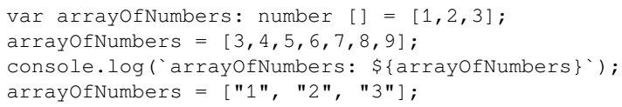
Arrays
Besides the base JavaScript types of string, number, and boolean, TypeScript has two other basic data types:
Arrays
Enums
An array is simply marked with the [ ] notation, similar to JavaScript, and each array can be strongly typed to hold a specific type, as seen in the code below:
The last line of this snippet, however, will generate the following error message:

Slide 39
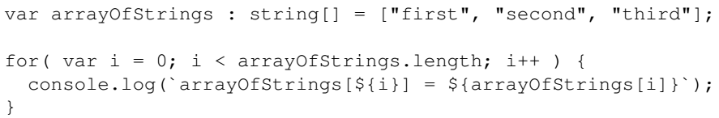
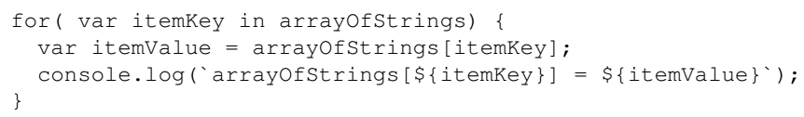
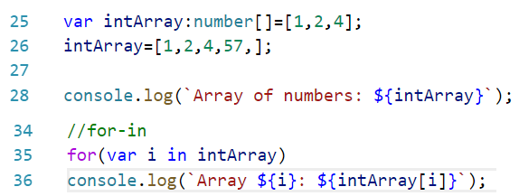
for..in and for..of
When working with arrays, it is common practice to loop through array items in order to perform some task.
This is generally accomplished within a for loop by manipulating an array index, as shown in the following code:
TypeScript introduces the for...in syntax to simplify looping through arrays.
Here is an example of the above for loop expressed using this new syntax:

Slide 40

for..in and for..of |
If we do not necessarily need to know the keys of the array, and are simply interested in the values held within the array, we can further simplify looping through arrays using the for...of syntax. Consider the following code:

Slide 41


The any Type
Consider the following valid JavaScript code snippet:
Unfortunately, this is not valid TypeScript code, and will generate the following error:
TypeScript introduces the any type for such occasions.
Specifying that an object has a type of any, in essence, relaxes the compiler's strict type checking.
The following code shows how to use the any type:

Slide 42
The any Type |
Note how our first line of code has changed. We specify the type of the variable item1 to be of type : any.
This special TypeScript keyword then allows a variable to follow JavaScript's loosely defined type rules, so that anything can be assigned to anything.
Without the type specifier of : any, the second line of code would normally generate an error.

Slide 43
Explicit Casting
As with any strongly typed language, there comes a time where you need to explicitly specify the type of an object.
An object can be cast to the type of another by using the < > syntax.
Let's take a look at an example that uses explicit casting, as follows:
Here, have now replaced the : any type specifier on the left-hand side of the assignment, with an explicit cast of <any> on the right-hand side.
This tells the compiler to explicitly treat the { id: 1, name: "item 1" } object on the right-hand side of the assignment operator as a type of any.
So the item1 variable on the left-hand side of the assignment, therefore, also has the type of any (due to TypeScript's inferred typing rules).
This then allows us to assign an object with only the { id: 2 } property to the variable item1 on the second line of code.

Slide 44
Explicit Casting |
This technique of using the < > syntax on the right-hand side of an assignment is called explicit casting.
While the any type is a necessary feature of the TypeScript language and is used for backward compatibility with JavaScript, its usage should really be limited as much as possible.
As we have seen with untyped JavaScript, over-use of the any type will quickly lead to coding errors that will be difficult to find.
Rather than using the type any, try to figure out the correct type of the object you are using, and then use this type instead.
We use an acronym within our programming teams–Simply Find an Interface for the Any Type (S.F.I.A.T) pronounced as sviat or sveat.
While this may sound silly, it brings home the point that the any type should always be replaced with an interface, so simply find it.
An interface is a way of defining custom types in TypeScript, which we will cover in the next chapter.
Just remember that, by actively trying to define what an object's type should be, we are building strongly typed code, and therefore, protecting ourselves from future coding errors and bugs.

Slide 45
NOTE
This is not a cast in the strictest sense of the word; it is more of an assertion that is used at runtime by the TypeScript compiler.
Any explicit casting that you use will be compiled away in the resultant JavaScript and will not affect the code at runtime.

Slide 46
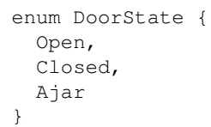
Enums
Enums are a special type borrowed from other languages such as C#, C++, and Java, and provides a solution to the problem of special numbers.
An enum associates a human readable name for a specific number. Consider the following code:
Under the hood, TypeScript will assign a numeric value to each of these human-readable enum values.
In this example, the DoorState.Open enum value will equate to a numeric value of 0.
Likewise, the enum value DoorState.Closed will equate to the numeric value of 1, and the DoorState.Ajar enum value will equate to 2.
Let's take a quick look at how we would use these enum values:

Slide 47
Enums |
Now let's use this enum in a slightly different way:
This sample clearly shows that the enum value of DoorState.Closed is the same as the enum value of DoorState["Closed"], because both variants resolve to the numeric value of 1.
Finally, let's take a look at what happens when we reference an enum using an array type syntax:
Here, we assign the variable ajarDoor to an enum value based on the second index value of the DoorState enum.
The output of this code, though, is surprising:

Slide 48
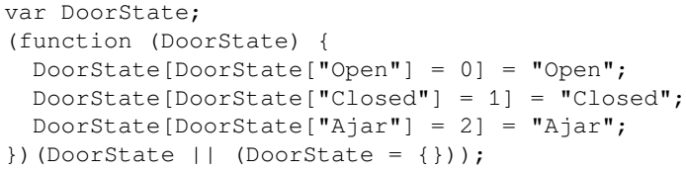
Enums ||
You may have been expecting the output to be simply 2, but here we are getting the string "Ajar", which is a string representation of our original enum name.
This is actually a neat little trick allowing us to access a string representation of our enum value.
The reason that this is possible is down to the JavaScript that has been generated by the TypeScript compiler.
Let's take a look, then, at the closure that the TypeScript compiler has generated:
This strange-looking syntax is building an object that has a specific internal structure.
It is this internal structure that allows us to use this enum in the various ways that we have just explored.

Slide 49
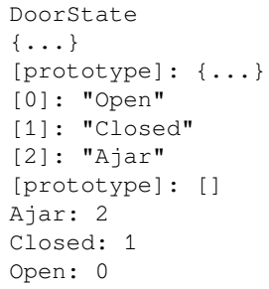
Enums |||
If we interrogate this structure while debugging our JavaScript, we will see that the internal structure of the DoorState object is as follows:
The DoorState object has a property called "0", which has a string value of "Open".
Unfortunately, in JavaScript the number 0 is not a valid property name, so we cannot access this property by simply using DoorState.0.
Instead, we must access this property using either DoorState[0] or DoorState["0"].
The DoorState object also has a property named Open, which is set to the numeric value 0.
The word Open is a valid property name in JavaScript, so we can access this property using DoorState["Open"], or simply DoorState.Open, which equates to the same property in JavaScript.

Slide 50
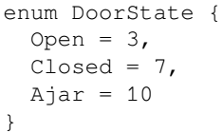
Enums ||||
While the underlying JavaScript can be a little confusing, all we need to remember about enums is that they are a handy way of defining an easily remembered, human-readable name to a special number.
Using human-readable enums, instead of just scattering various special numbers around in our code, makes the intent of the code clearer.
Using an application-wide value named DoorState.Open or DoorState.Closed is far simpler than remembering to set a value to 0 for Open, 1 for Closed, and 3 for Ajar.
As well as making our code more readable and more maintainable, using enums also protects our code base whenever these special numeric values change because they are all defined in one place.
One last note on enums, is that we can set the numeric value manually, if required:
Here, we have overridden the default values of the enum to set DoorState.Open to 3, DoorState.Closed to 7, and DoorState.Ajar to 10.

Slide 51
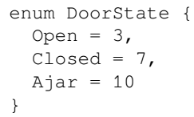
Manual Numeric Values
We can set the numeric value of an enum manually, if required:

Slide 52
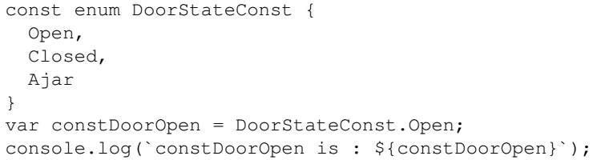
Const enums
A slight variant of the enum type is the const enum, which simply adds the keyword const before the enum definition, as follows:
const enums have been introduced largely for performance reasons, and the resultant JavaScript will not contain the full closure definition for the DoorStateConst enum as we saw previously.
Let's take a quick look at the JavaScript that is generated from this DoorStateConst enum:
With const enums, we therefore cannot reference the internal string value of an enum, as we did in our previous code sample.
If we try to reference a const enum using the array syntax, as follows:

Slide 53
Const enums |
We get the following error message: error TS2476:
We can, however, still use the string property accessor on a const enum, as follows:
When using const enums, the compiler will strip away all enum definitions and simply substitute the numeric value of the enum directly into our JavaScript code.

Slide 54

Const values
The TypeScript language also allows us to define a variable as a constant, by using the const keyword.
If a variable has been marked as const, then its value can only be set when the variable is defined, and cannot be changed afterwards.
Consider the following code:
Here, we have defined a variable named constValue, and indicated that it cannot be changed by using the const keyword.
Attempting to compile this code will result in the following compile error:

Slide 55

The let Keyword
JavaScript:
Variables in JavaScript are defined by using the keyword var.
The JavaScript runtime is very lenient when it comes to variable definitions.
If the JavaScript runtime comes across a variable that has not been previously defined or given a value, then the value for this variable will be undefined.
Consider the following code snippet:
Using the var keyword does not check to see whether the variable itself has been defined before we actually use it.
This could obviously lead to unwanted behavior, as the value of an undefined or unallocated variable is always undefined.
TypeScript:
TypeScript introduces the let keyword, which can be used in the place of the var keyword when defining variables.

Slide 56
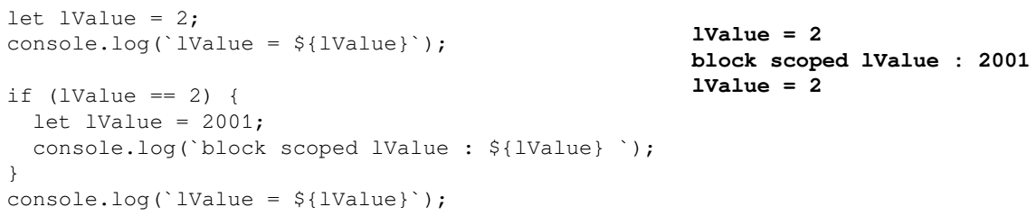
The let Keyword |
One of the advantages of using the let keyword is that we cannot use a variable name before it has been defined. Consider the following code:
Another side-effect of using the let keyword, is that variables defined with let are block-scoped.
This means that their value and definition are limited to the block of code that they reside in.
As an example of this, consider the following code:

Slide 57
Functions
Working with functions has more typing rules. Consider the following topics:
Function return types
Anonymous functions
Optional parameters
Default parameters
Rest parameters
Function callbacks
Function signatures
Function overloads

Slide 58
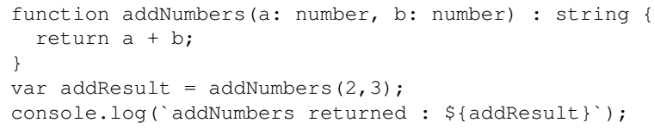
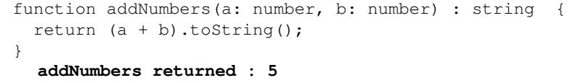
Function return types
TypeScript allows us to define the type of a variable that a function should return.
Consider the following TypeScript code:
This code will generate an error message as follows:
The function itself is returning a number, and not a string – hence the error.
To fix this code, then, we need to ensure that the function returns a string, as follows:

Slide 59
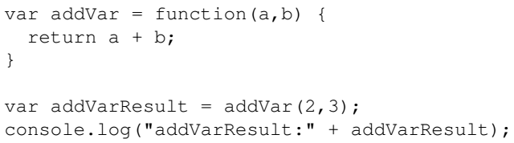
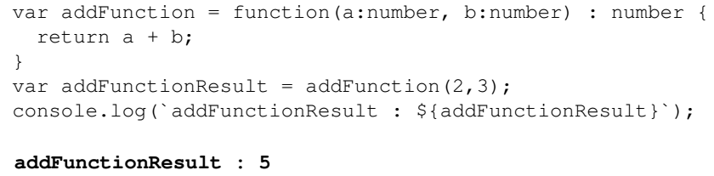
Anonymous functions
Anonymous functions are defined on the fly and don't specify a function name.
Consider the following JavaScript code:
The TypeScript version of the same function is as follows:
TypeScript allows anonymous functions in the same way that JavaScript does, but also allows standard type annotations.

Slide 60
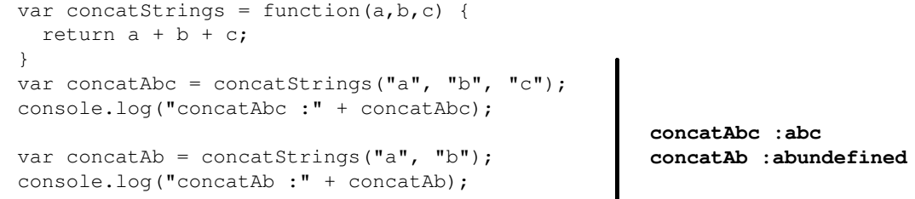
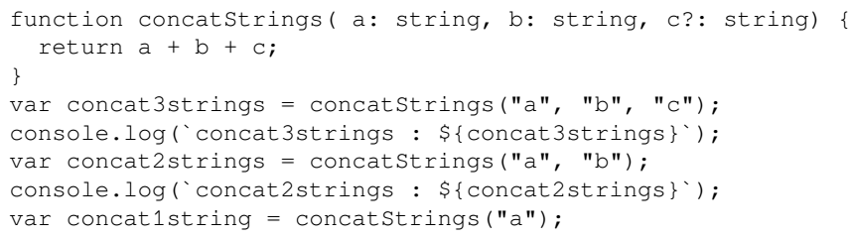
Optional parameters
When we call a JavaScript function that is expecting parameters, and we do not supply these parameters, then the value of the parameter within the function will be undefined.
As an example of this, consider the following JavaScript code:
TypeScript introduces the question mark ? syntax to indicate optional parameters.
This allows us to mimic the JavaScript calling syntax where we can call the same function with some missing arguments. As an example of this, consider the following TypeScript code:

Slide 61
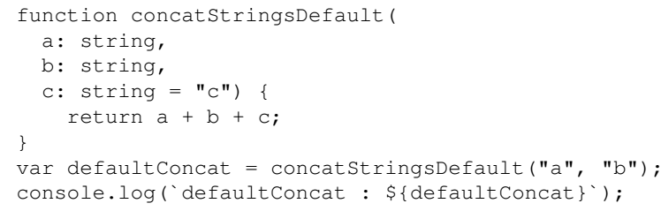

Default parameters
A subtle variant of the optional parameter syntax allows us to specify the default value of a parameter.
If an optional parameter value is not supplied, we can specify what the default value of this optional parameter should be.
Let's modify our preceding function definition to use an optional parameter with a default value, as follows:
This function definition has now dropped the ? optional parameter syntax, but instead has assigned a value of "c" to the last parameter: c:string = "c".
The output of this code will therefore be:

Slide 62
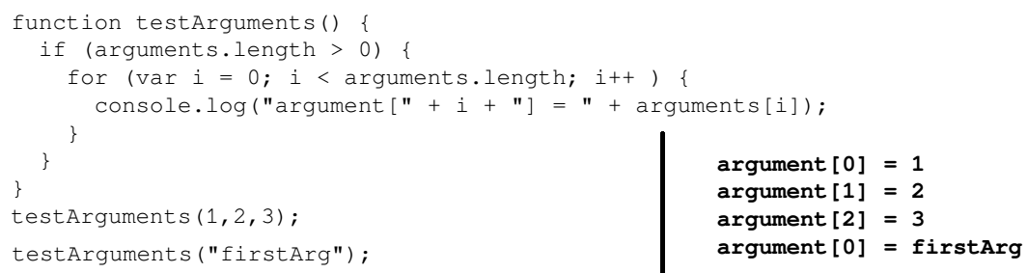
Rest parameters
The JavaScript language also allows a function to be called with a variable number of arguments.
Every JavaScript function has access to a special variable, named arguments, that can be used to retrieve all arguments that have been passed into the function.
As an example of this, consider the following JavaScript code:\
In order to express the equivalent function definition in TypeScript, we will need to use a syntax that is known as the rest parameter syntax.
Rest parameters use the TypeScript syntax of three dots (...) in the function declaration to express a variable number of function parameters.
Here is the equivalent testArguments function, expressed in TypeScript:

Slide 63
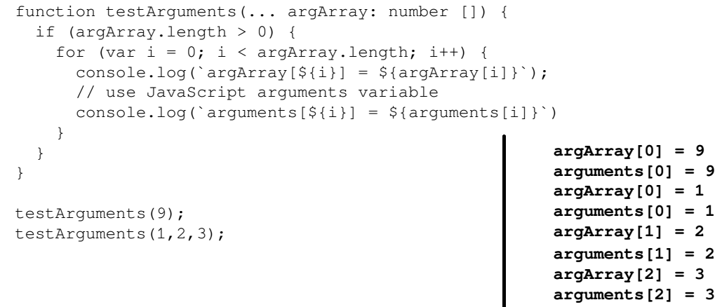
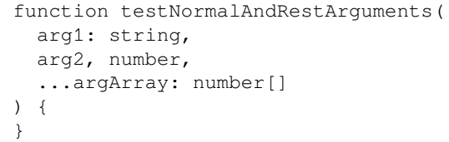
Rest parameters |
The ...argArray: number[ ] syntax for our testArguments function parameters instructs the TypeScript compiler that the function can accept any number of arguments.
The internal arguments array does not have an inferred type, and so will be treated as the any type.
We can also combine normal parameters along with rest parameters in a function definition, as long as the rest parameters are the last to be defined in the parameter list, as follows:

Slide 64
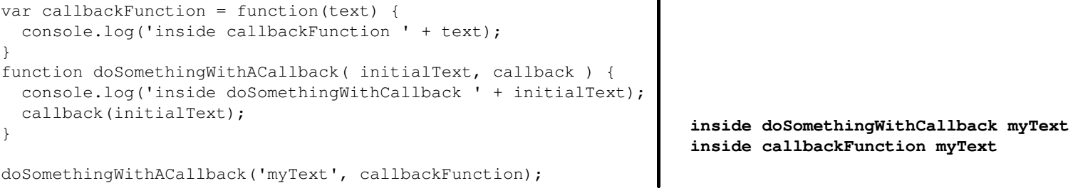

Function callbacks
One of the most powerful features of JavaScript – and in fact the technology that Node was built on – is the concept of callback functions.
A callback function is a function that is passed into another function, and is then generally invoked inside the function.
Since JavaScript is not strongly typed, we can pass a value into a function and pass a function into a function.
This is best illustrated by taking a look at some sample JavaScript code:
If we inadvertently called the doSomethingWithACallback function with two strings, as shown below; we would get a JavaScript runtime error:

Slide 65
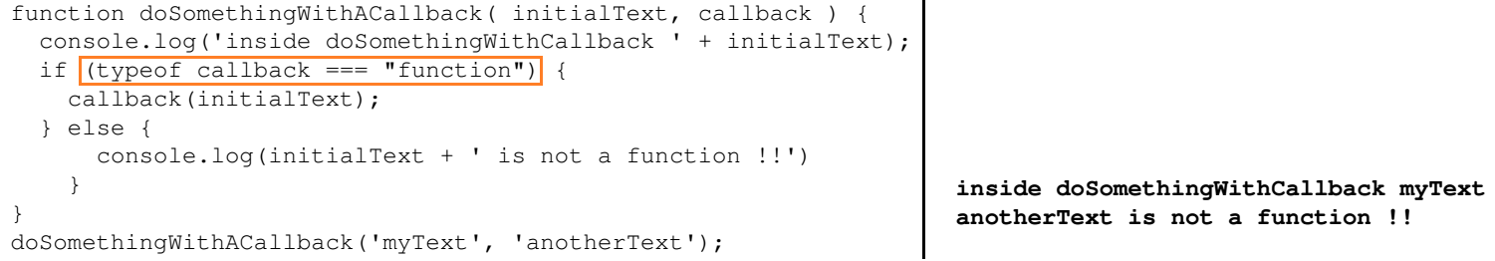
Function callbacks |
Defensively minded programmers, however, would first check whether the callback parameter was in fact a function before invoking it, as follows:

Slide 66
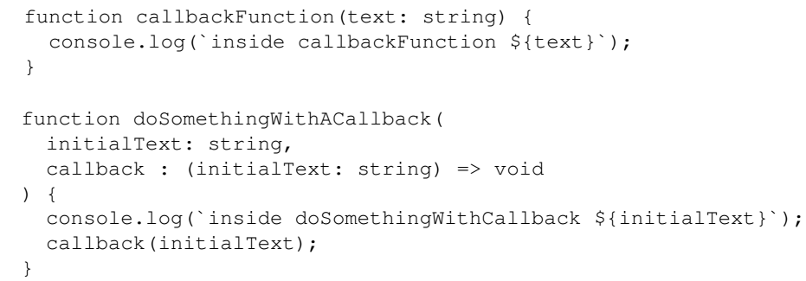
Function signatures
TypeScript introduces the fat arrow syntax, ( ) => to functions which implies that one of the parameters to a function needs to be another function.
Lets’ rewrite our previous JavaScript callback sample in TypeScript, as follows:
The doSomethingWithACallback function will only accept, as its second argument, a function that takes a single string parameter and returns void.
We can then use this function as follows:

Slide 67
Function overloads

Slide 68
Advanced types
TypeScript also has some advanced language features that can be used when working with basic types and objects:
Union types
Type guards
Type aliases
Null and undefined
Object rest and spread

Slide 69
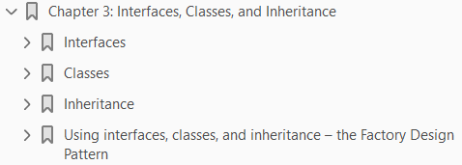
3
Types, Classes, and Inheritance

Slide 70
Intro
TypeScript uses basic types, inferred types, and function signatures to bring a strongly typed development experience to JavaScript.
TypeScript also introduces object-oriented features that are similar to other languages, including interfaces, classes, and inheritance.
These object-oriented language constructs are part of the ECMAScript 6 standard, and as such will be included in future versions of JavaScript.
TypeScript allows us, therefore, to use these new object-oriented features from upcoming JavaScript versions in our code base.
TypeScript compiler will take care of generating compatible ECMAScript 3 or ECMAScript 5 JavaScript code when we use these language features.

Slide 71
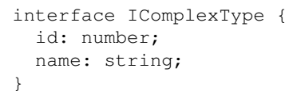

Interfaces
An interface provides us with a mechanism to define what properties and methods an object must implement, and is, therefore, a way of defining a custom type.
We can strongly type a variable to be of an interface type. If an object adheres to an interface, it is said that the object implements the interface.
Interfaces are defined by using the interface keyword. Consider the following TypeScript code:
This interface definition can then be applied to a variable, as follows:

Slide 72

Interfaces |
If we attempt to create an instance of the object without both of these properties, TypeScript will generate the following error:

Slide 73
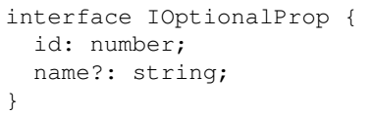
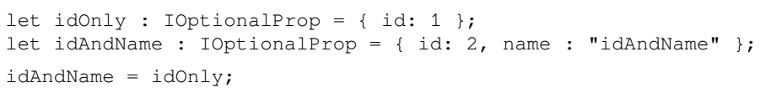
Optional properties
Interface definitions may also include optional properties, similar to the way that functions may have optional properties.
Consider the following interface definition:
The ? character after the name property is used to specify that this property is optional. We can therefore use this interface definition, as follows:
In the above example both variables are implementing the IOptionalProp interface; as such, we are able to assign them to each other.

Slide 74
Interface compilation
Interfaces are a compile-time language feature of TypeScript, and the compiler does not generate any JavaScript code from interfaces that you include in your TypeScript projects.
Interfaces are only used by the compiler for type checking during the compilation step.

Slide 75
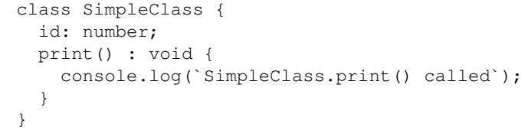
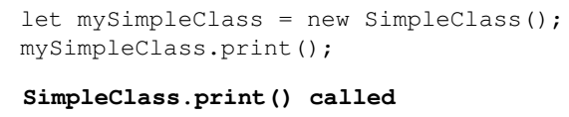
Classes
A class is a definition of an object, what data it holds, and what operations it can perform.
Classes and interfaces form the cornerstone of the principles of object-oriented programming, and often work together in design patterns.
A design pattern is a way of using classes and interfaces in a certain way to help tackle common programming problems.
Let's take a look at a simple class definition:
We used the class keyword to define a class named SimpleClass, and we have defined this class to have a property named id, and a print function.
We can then use this class, as follows:

Slide 76
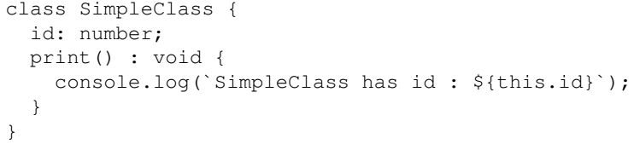
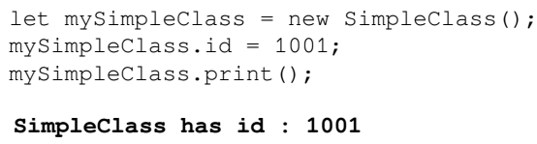
Class properties
In order to access the properties of a class from within a class itself, we need to use the this keyword.
As an example of this, consider the below code:
We can now set the id property of the class instance, and call the updated print function, as follows:

Slide 77
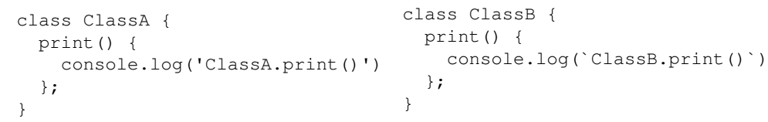

Implementing interfaces
Both classes and interfaces have properties and functions.
The difference is that classes must implement functions and properties, whereas interfaces only describe them.
This allows us to use interfaces to describe some common behaviors of a group of classes, and then write code that will work with any one of these classes.
Consider the following class definitions:
Instead of writing a complex class that needs to deal with instances of both ClassA and ClassB, we can easily create an interface describing the behavior we need, as follows:

Slide 78
Implementing interfaces |
We can now modify our class definitions to ensure that they can both be used by the printClass function, as follows:
Our class definitions now use the implements keyword to implement the IPrint interface.
This allows us to use both classes within the printClass function, as follows:
Interfaces offer a way of describing class behavior
They are a type of contract that classes must implement, if they are expected to provide certain behaviors.

Slide 79
Class constructors

Slide 80
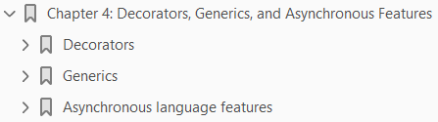
4
Decorators, Generics, and Asynchronous Features

Slide 81
Intro
Above and beyond the concepts of classes, interfaces, and inheritance, the TypeScript language introduces a number of advanced language features in order to aid the development of robust object-oriented code.
These features include
Decorators
Generics
Promises
the use of the async and await keywords when working with asynchronous functions
Decorators allow for the injection and query of metadata when working with class definitions, as well as the ability to programmatically attach to the act of defining a class.
Generics provide a technique for writing routines where the exact type of an object used is not known until runtime.
Promises provide the ability to write asynchronous code in a fluent manner, and async await functions will pause execution until an asynchronous function has completed.
When writing large-scale JavaScript applications, these language features become part of the programmers' toolbox and allow for the application of many design patterns within JavaScript code.

Slide 82
Intro |
This chapter is broken into three parts.
The first part covers decorators, the second part covers generics, and the third part deals with asynchronous programming techniques using promises and async await.
In earlier versions of TypeScript, promises and async await could only be used in ECMAScript 6 and above, but this functionality has now been extended to include ECMAScript 3 targets.

Slide 83
Agenda
We will cover the following topics in this chapter:
Decorators syntax
Decorator factories
Class, method, and parameter decorators
Decorator metadata
Generics syntax
Using and constraining the type of T
Generic interfaces
Promises and promise syntax
Using promises
Async and await
Handling await errors

Slide 84
Decorators
Decorators in TypeScript provide a way of programmatically tapping into the process of defining a class.
Remember that a class definition describes the shape of a class.
In other words, a class definition describes
what properties a class has
what methods it defines
It is only when a class is instantiated, that is, when an instance of the class is created that these properties and methods become available.
Decorators; however, allow us to inject code into the actual definition of a class.
Decorators can be used on
class definitions
class properties
class functions,
even method parameters.
The concept of decorators exists in other programming languages, and are called attributes in C#, or annotations in Java.

Slide 85
Decorators |
In this section, we will explore
what decorators are
how they are defined
how they can be used
We will look at
Class
Property
function,
method decorators
Decorators are an experimental feature of the TypeScript compiler, and have been proposed as part of the ECMAScript 7 standard.
TypeScript, however, allows for the use of decorators in ES3 and above.
In order to use decorators, a new compile option needs to be added to the tsconfig.json file in the root of your project directory.
This option is named experimentalDecorators, and needs to be set to true, as follows: Code 4-1.

Slide 86
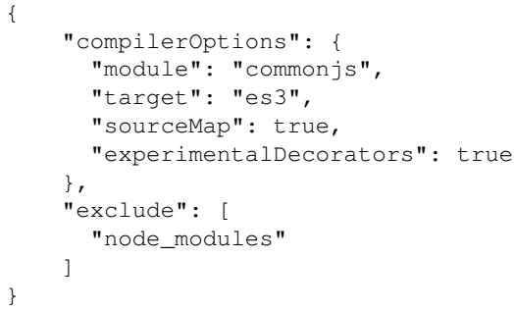
Code 4-1

Slide 87
Generics
Generics are a way of writing code that will deal with any type of object but still maintain the object type integrity. So far, we have used interfaces, classes, and TypeScript's basic types to ensure strongly typed (and less error-prone) code in our samples. But what happens if a block of code needs to work with any type of object? As an example, suppose we wanted to write some code that could iterate over an array of objects and return a concatenation of their values. So, given a list of numbers, say [1,2,3], it should return the string "1,2,3". Or, given a list of strings, say ["first","second","third"], return the string "first,second,third". We could write some code that accepted values of type any, but this might introduce bugs in our code, remember S.F.I.A.T.? We want to ensure that all elements of the array are of the same type. This is where generics come in to play.
(Page 146).

Slide 88
Asynchronous language features
In this section of the chapter, we will discuss some asynchronous language features, and in particular, promises and the async and await keywords. The code samples in this section have been designed to run on Node version 4 and above, which provides an ECMAScript 6 runtime. You can determine which version of Node you are running by executing the following on the command line:
(Page 157).

Slide 89
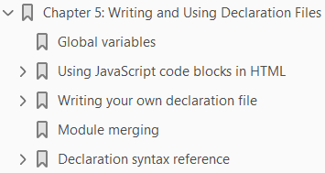
5
Writing and Using Declaration Files

Slide 90
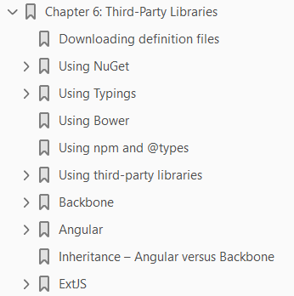
6
Third-Party Libraries

Slide 91
TypeScript History

Slide 92
TypeScript History
TypeScript is an open-source programming language developed and maintained by Microsoft.
It is a strict syntactical superset of JavaScript, and adds optional static typing to the language and Anders Hejlsberg has worked on the development of TypeScript.
TypeScript may be used to develop JavaScript applications for client-side or server-side (Node.js) execution.
It is designed for development of large applications and transpile to JavaScript.
As TypeScript is a superset of JavaScript, existing JavaScript programs are also valid TypeScript programs.
TypeScript supports definition files that can contain type information of existing JavaScript libraries, much like C++ header files can describe the structure of existing object files.
This enables other programs to use the values defined in the files as if they were statically typed TypeScript entities. There are third-party header files for popular libraries such as jQuery, MongoDB, and D3.js.
TypeScript headers for the Node.js basic modules are also available, allowing development of Node.js programs within TypeScript.
The TypeScript compiler is itself written in TypeScript and compiled to JavaScript. It is licensed under the Apache 2 License.

Slide 93
TypeScript History |
TypeScript is included as a first-class programming language in Microsoft Visual Studio 2013 Update 2 and later, beside C# and other Microsoft languages.

Slide 94
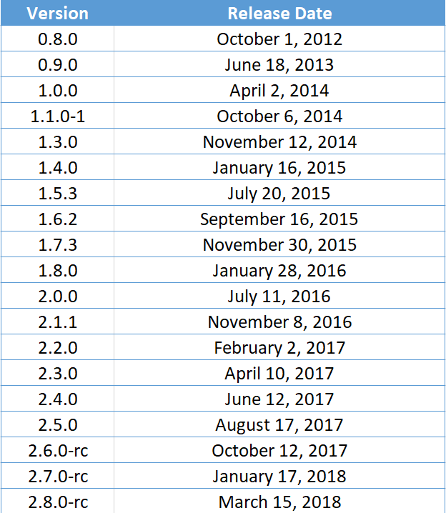
Release

